Slide 1

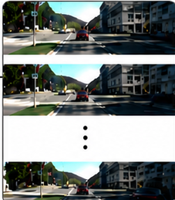
Video Frames
iKUN
Model
Cosine similarity
Yes
Matched
+
final_score > 0 ?
No
Mismatched
Object Tracklets
(bbox + track ID)
Motion
Projector
256D Motion Vector
Shared Weight
MLP
256D Motion Vector
Object bbox
12D Motion Vector
Cosine
Similarity
384D Embeddings
256D Motion Vector
Language
Projector
256D Motion Vector
Expressions
(e.g. Cars Moving)
Text
Encoder
GMC-Link

